Slide 1

Employee Retention
Domain: HR ANALYTICS

Slide 2

GROUP 5
Afreen
Lalit
Akshay
Siya
Samyak
Viraj

Slide 3


KPI’S
1. Average Attrition rate for all Departments
2. Average Hourly rate of Male Research Scientist
3. Attrition rate Vs Monthly income stats
4. Average working years for each Department
5. Job Role Vs Work life balance
6. Attrition rate Vs Year since last promotion relation

Slide 4
1. Average Attrition rate for all Departments
Observation:
Research & Development having 51.21% Highest Average Attrition Rate. Hardware having 49.44% lowest Average Attrition Rate.
Suggestions:
Conduct exit interviews to understand the specific reasons behind the high attrition in Research & Development.
Implement targeted retention programs and mentorship initiatives to enhance job satisfaction and career growth in the affected department.

Slide 5
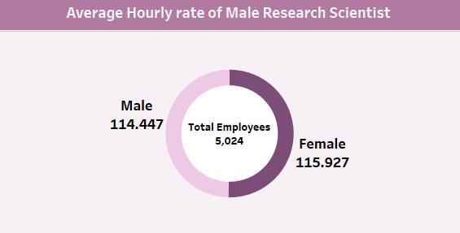
2. Average Hourly rate of Male Research Scientist
Observation:
Total Employees is 5024. Average hourly rate of Male Research Scientist is 114.447.
Suggestions:
Benchmark the hourly rates against industry standards to ensure competitive compensation.
Conduct a comprehensive salary review to identify and address any gender-based pay disparities that may exist within the Male Research Scientist category.

Slide 6
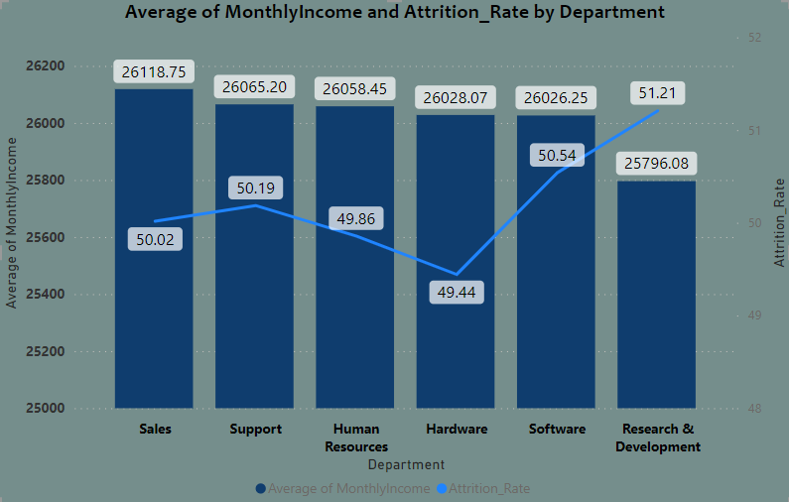
3. Attrition rate Vs Monthly income stats
Observation:
Sales Having 26,118.75 highest Attrition rate vs Monthly income stats. Research and development having 25796.08 lowest Attrition rate vs Monthly income stats.
Suggestions:
Analyze the correlation between income levels and job satisfaction in the Sales department.
Introduce performance-based incentives or bonuses to improve retention in high-attrition departments

Slide 7
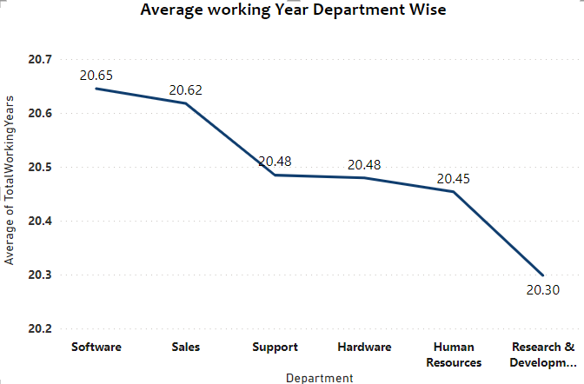
4. Average working years for each Department
Observation:
Software having 20.65 highest Average working year. Research & Development having 20.30 lowest Average working year.
Suggestions:
Investigate the reasons behind the longer tenure in the Software department and apply successful practices to other departments.
Implement career development programs to enhance employee engagement and longevity.

Slide 8
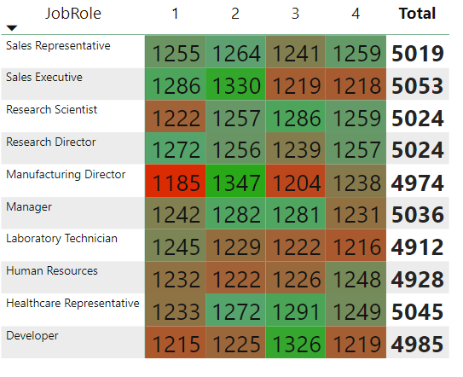
5. Job Role Vs Work life balance
Observation:
Employees with job role sales executive and healthcare representative have a good work life balance when compared to employee with job role Laboratory technician seems to have no work balance
Suggestions:
Assess workload distribution and job responsibilities in the Laboratory Technician role.
Promote flexible work arrangements and employee wellness programs to improve work-life balance across all roles.

Slide 9
6. Attrition rate Vs Year since last promotion relation
Observation:
Employees between 30 to 40 show high attrition rates, especially those promoted at ages 40,37, and 36.
Suggestions:
Evaluate the impact of promotions on job satisfaction and retention.
Implement targeted training and development programs for employees approaching promotion age to ensure a smooth transition.

Slide 10
Conclusion
1. Keeping Our Team Happy:
🌟 Figuring out what makes each department stay or sway.🗣️ Chatting with departing team members to improve our workplace play.
2.Fair Pay Playlist:
💸 Checking if everyone's pay is fair and square.📊 Making sure no one's missing a note with fair gender pay.
3. Income & Smiles Connection:
💼 Giving bonuses that make people smile.📈 Seeing how salary vibes affect our workplace lifestyle.
4 .Long-Term Hits:
🎹 Learning from the long-term champs in Software.🚀 Setting up cool career stuff for everyone to share.
Let's keep the vibes positive and the work tunes groovy for a workplace where everyone sings along happily! 🎶😊✨

Slide 11
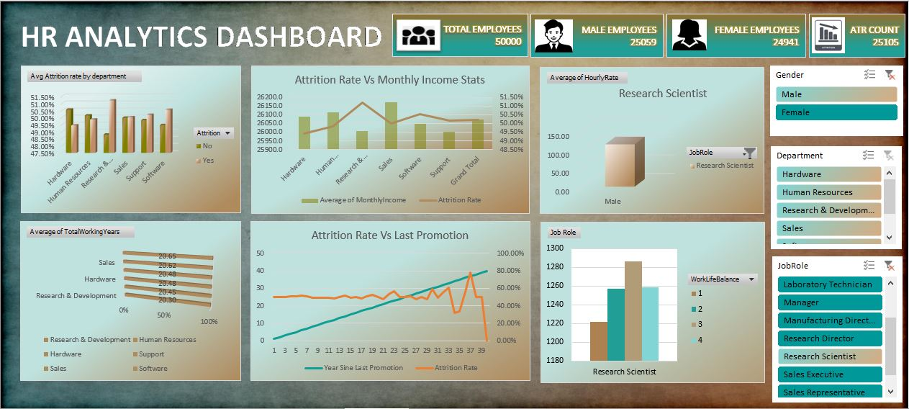
Notes:
Excel Dashboard

Slide 12
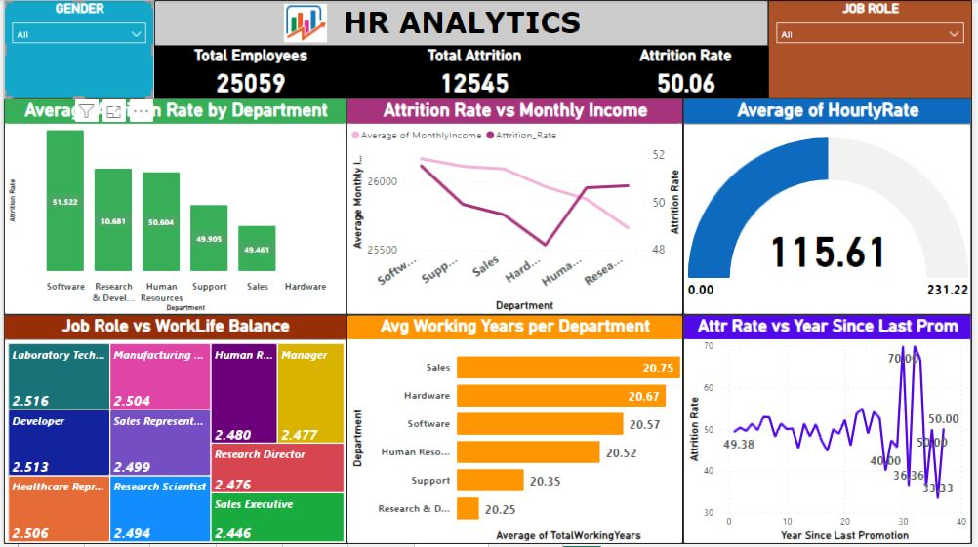
Notes:
PowerBI Dashboard

Slide 13
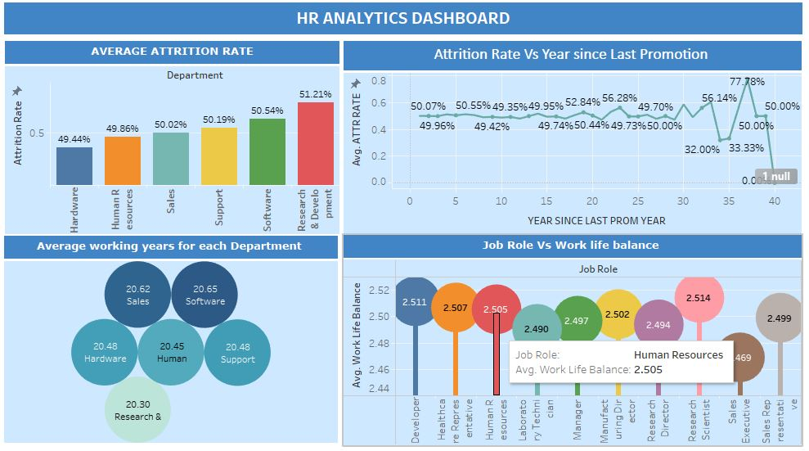
Notes:
Tableau DB1

Slide 14
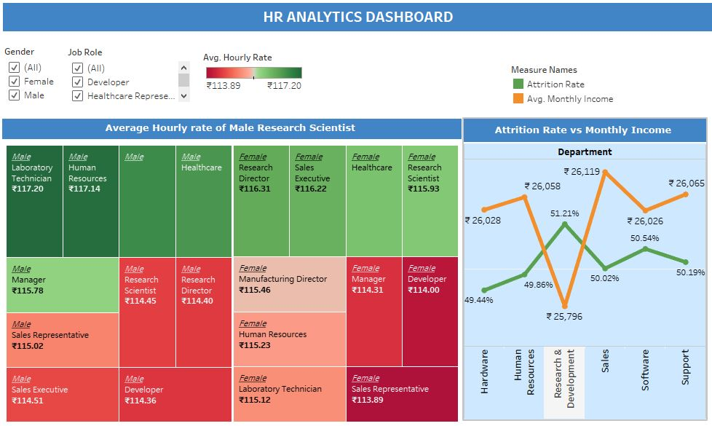
Notes:
Tableau DB2

Slide 15
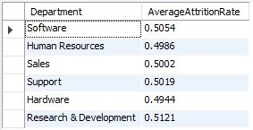
Average Attrition rate for all Departments
/*Q1 .Average Attrition rate for all Departments*/
SELECT Department,
AVG(CASE WHEN Attrition = 'Yes' THEN 1 ELSE 0 END) AS AverageAttritionRate
FROM hr_analytics
GROUP BY Department;

Slide 16

Average Hourly rate of Male Research Scientist
/*Q2 .Average Hourly rate of Male Research Scientist*/
SELECT JobRole,Gender,
AVG(HourlyRate) AS AverageHourlyRate
FROM hr_analytics where JobRole='Research Scientist' and Gender='Male';

Slide 17
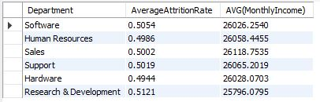
Attrition rate Vs Monthly income stats
/*Q3.Attrition rate Vs Monthly income stats*/
SELECT Department,
AVG(CASE WHEN Attrition = 'Yes' THEN 1 ELSE 0 END) AS AverageAttritionRate,
AVG(MonthlyIncome)
FROM hr_analytics
GROUP BY Department

Slide 18
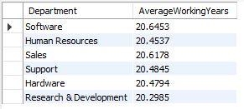
Average working years for each Department
/*Q4. Average working years for each Department*/
SELECT Department,
AVG(TotalWorkingYears) AS AverageWorkingYears
FROM hr_analytics
GROUP BY Department

Slide 19
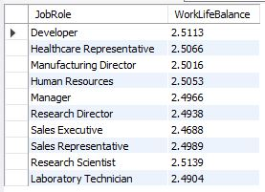
Job Role Vs Work life balance
/*Q5.Job Role Vs Work life balance*/
SELECT JobRole, AVG(WorkLifeBalance) AS WorkLifeBalance
FROM hr_analytics
GROUP BY JobRole

Slide 20
Attrition rate Vs Year since last promotion relation
/*Q6.Attrition rate Vs Year since last promotion relation*/
SELECT AVG(CASE WHEN Attrition = 'Yes' THEN 1 ELSE 0 END) AS AverageAttritionRate, YearsSinceLastPromotion
FROM hr_analytics
GROUP BY YearsSinceLastPromotion

Slide 21
